Slide 1

INTERNSHIP VIVA
Rahul Rathore
11702112

Slide 2
CONTENTS
OUR COMPANY
OBJECTIVE
PROBLEM DOMAIN
SOLUTION DOMAIN
APPLICABILITY
EXPECTED OUTCOME
APPLICATION WORKING
APPLICATION INSIGHTS
FUTURE PERSPECTIVE
CONCLUSION

Slide 3

OUR COMPANY
Xoriant is a Silicon Valley headquartered Product Engineering, Software Development , and Technology Services firm with offices in the U.S., Europe, and Asia.
Focus areas – Product Engineering, Cloud, Infrastructure & Security, Big Data & Analytics, Data Management & Governance, Digital, and IoT.
Aims Delivering Sustainable Business Solutions

Slide 4
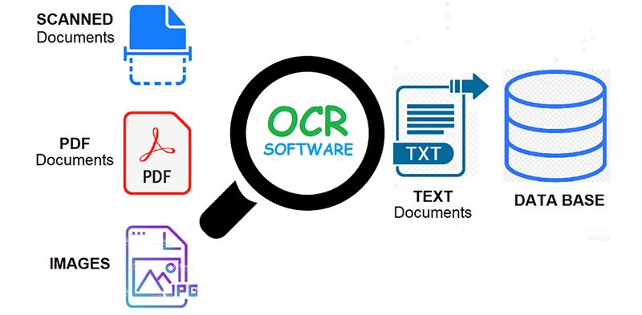
OBJECTIVE & ROLES
Role - Intern
The objective of this internship was to learn the basic practices of Software Development that is being used currently in the industry and to apply those tactics on to our company’s project whichever assigned.
API Development
OCR Service
Azure Cognitive Services

Slide 5

PROBLEM DOMAIN
To Automate the task of Document Digitization with least Manual Efforts
To deliver high performing software system for Digitization of Documents including Images, PDFs and other Document types
To Process Huge Number of Documents without any fail
ANALYSIS

Slide 6
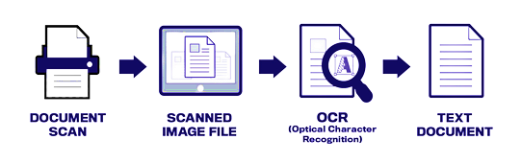
SOLUTION DOMAIN
OCR Backed Application which Widely used as a form of data entry from printed paper data records – Passport Documents, Invoices, Bank Statements, Computerized Receipts, Business cards, mail, printouts of static-data, or any suitable documentation

Slide 7
APPLICABILTY
These types of system can be implemented for
Data entry for business documents, e.g., Cheque, Passport, Invoice
In Schools and Colleges to digitize existing student records and new records on admission
In Healthcare sectors to digitize the Patient’s records
In Insurance Firms for documents key information extraction.
Extracting business card information into a contact list
More quickly make textual versions of printed documents
In businesses which require collection of physical copies of User Identity
SOLUTION

Slide 8





OUTCOMES
Automated
Complete Automated System
Saves Time
High Processing Speed
Cost Effective
Reduces Labour Cost
Minimizes Error Rate
Because Least Human Intervention
Highly Secure
No Data Leaks and Reliable

Slide 9
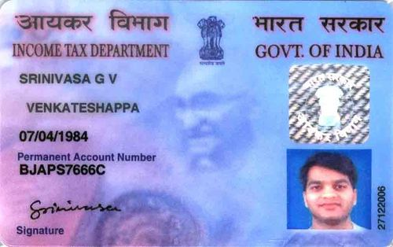
APPLICATION WORKING
Name
Father’s Name
DOB
Pancard Number

Slide 10

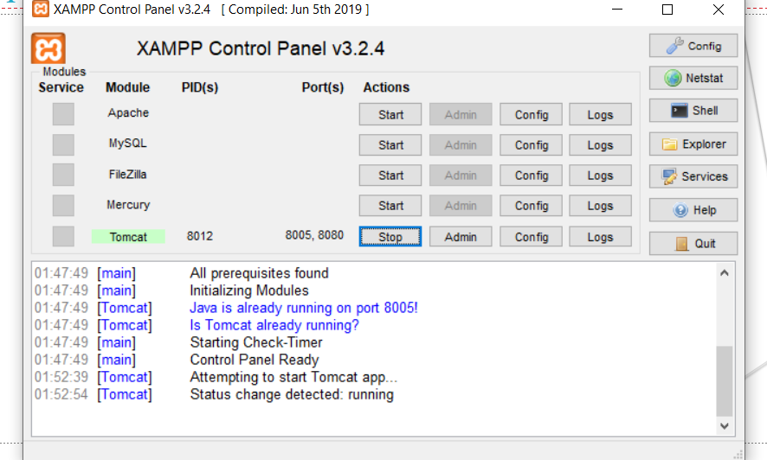
LOCAL SERVER

Slide 11
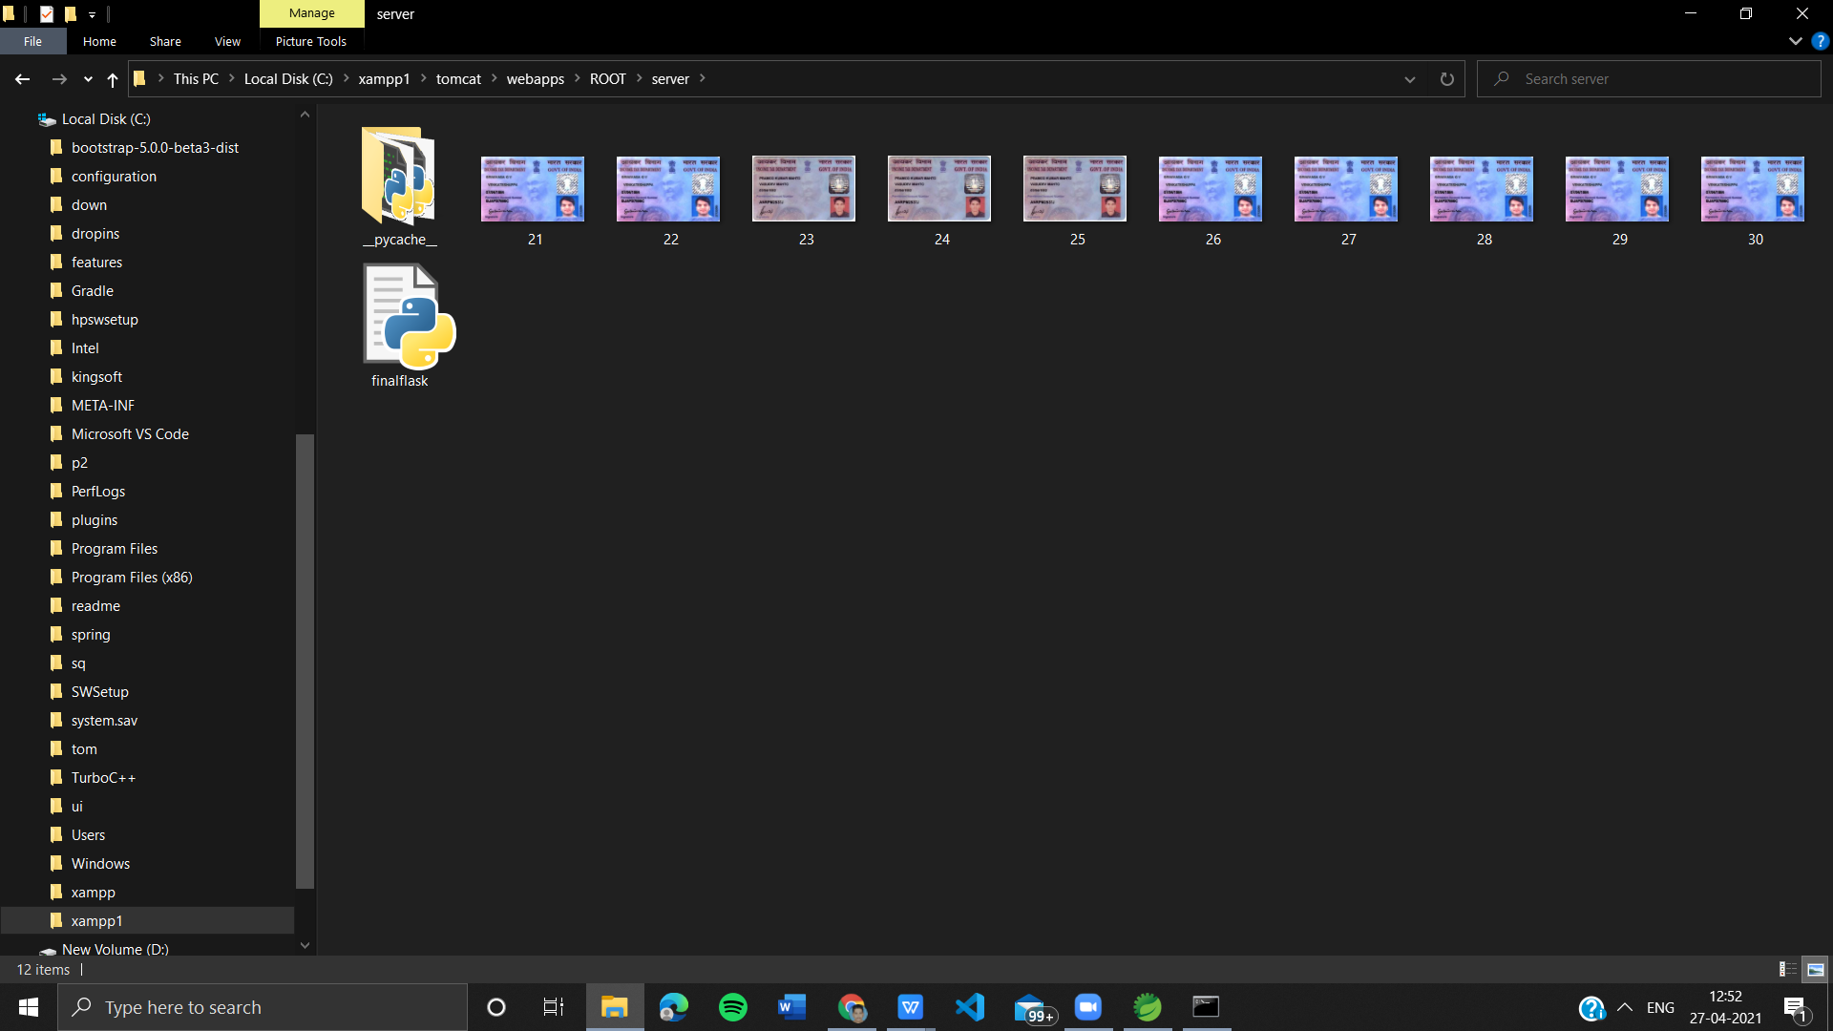
LOCAL STORAGE

Slide 12
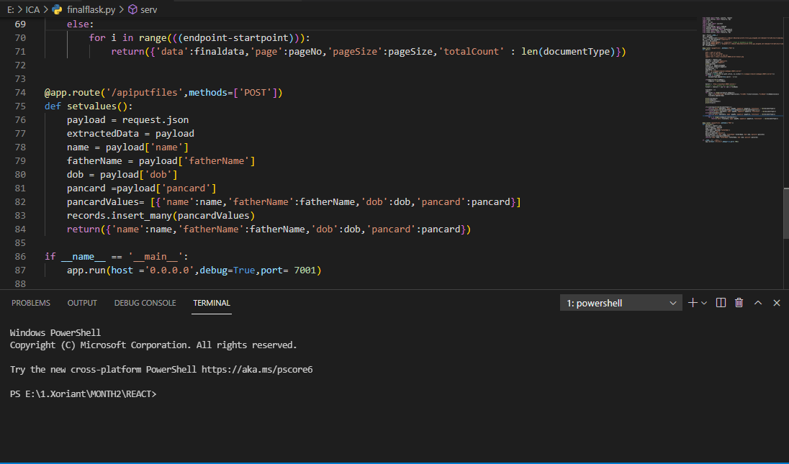
API PART

Slide 13
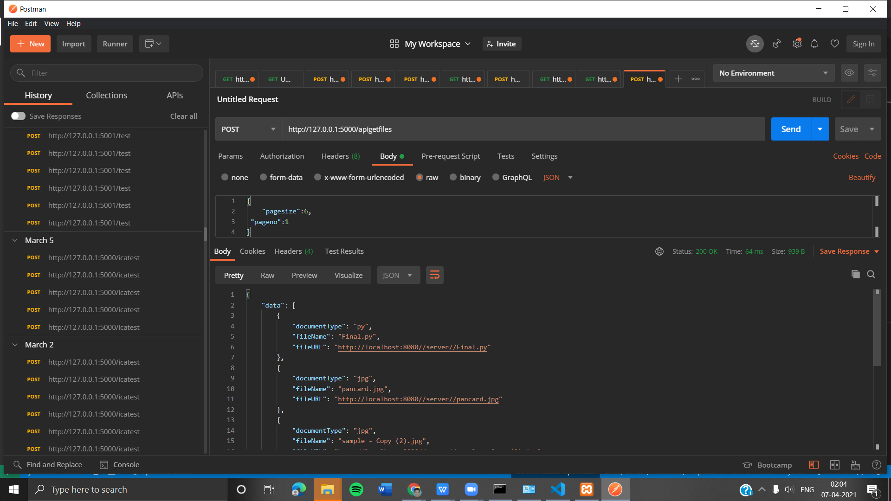
POSTMAN TO VERIFY PAYLOAD RESPONSE

Slide 14
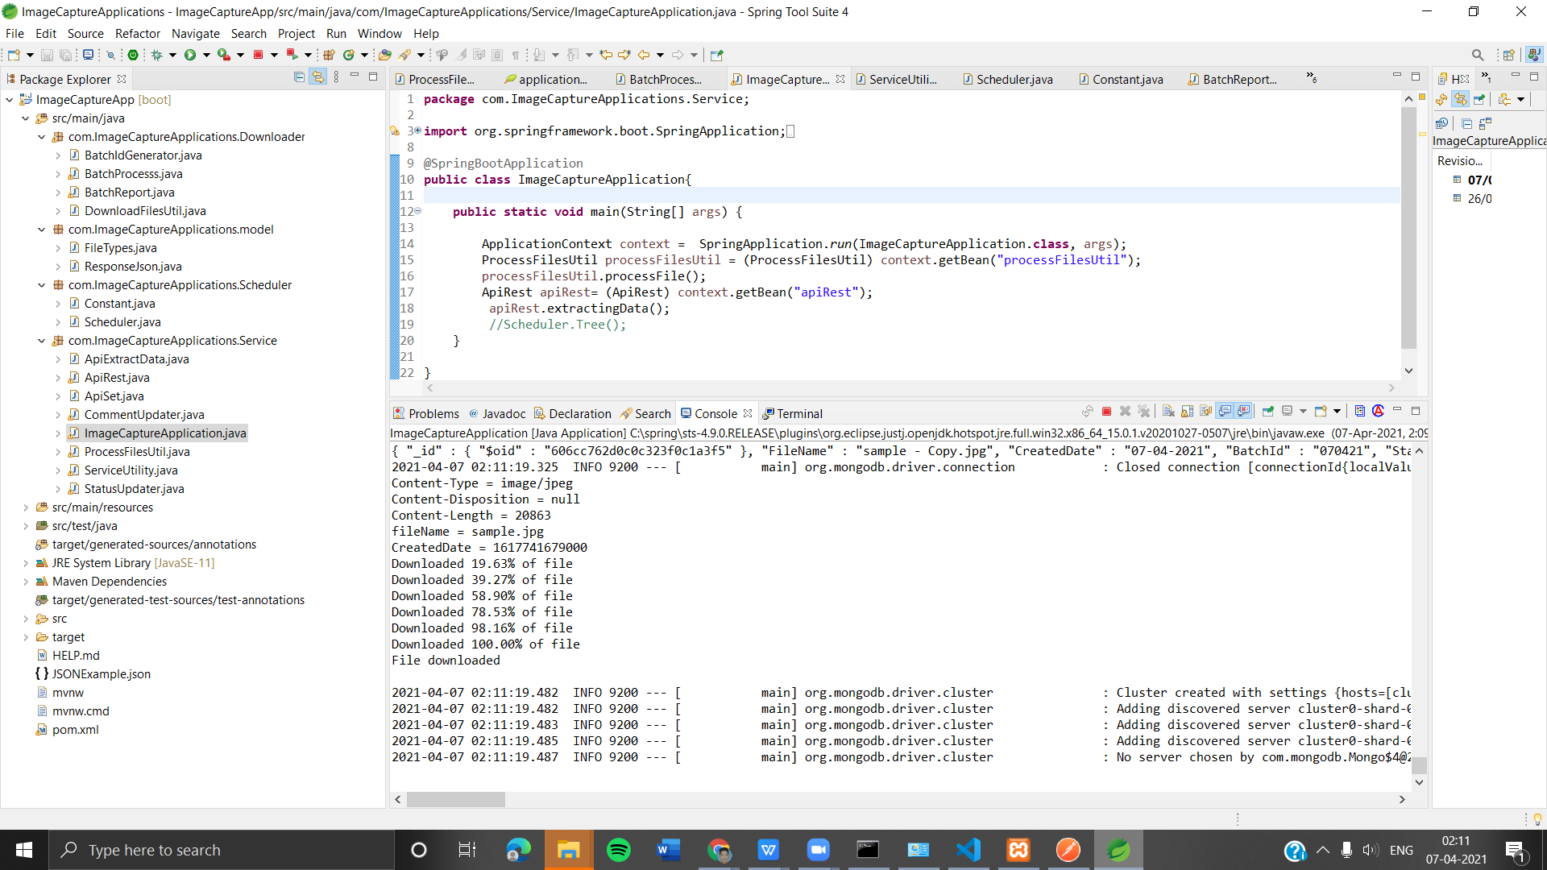
APPLICATION OVERVIEW

Slide 15
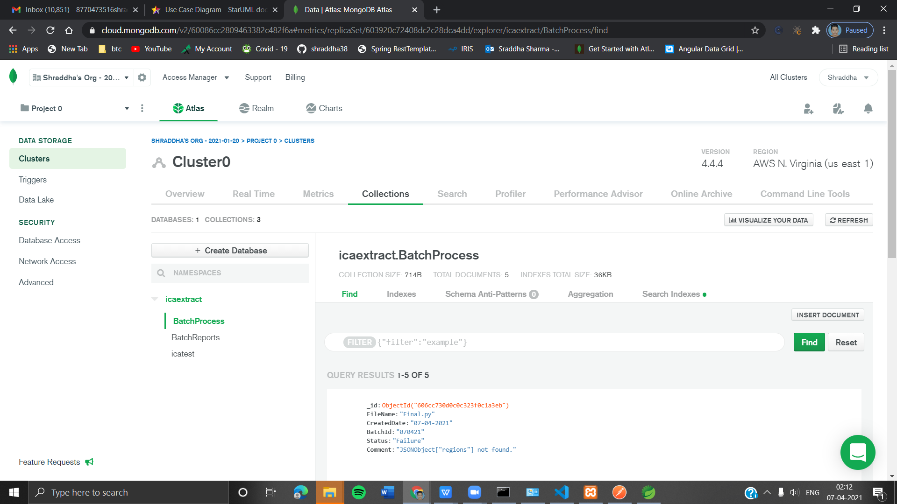
CLOUD STORAGE DB (MONGODB)

Slide 16
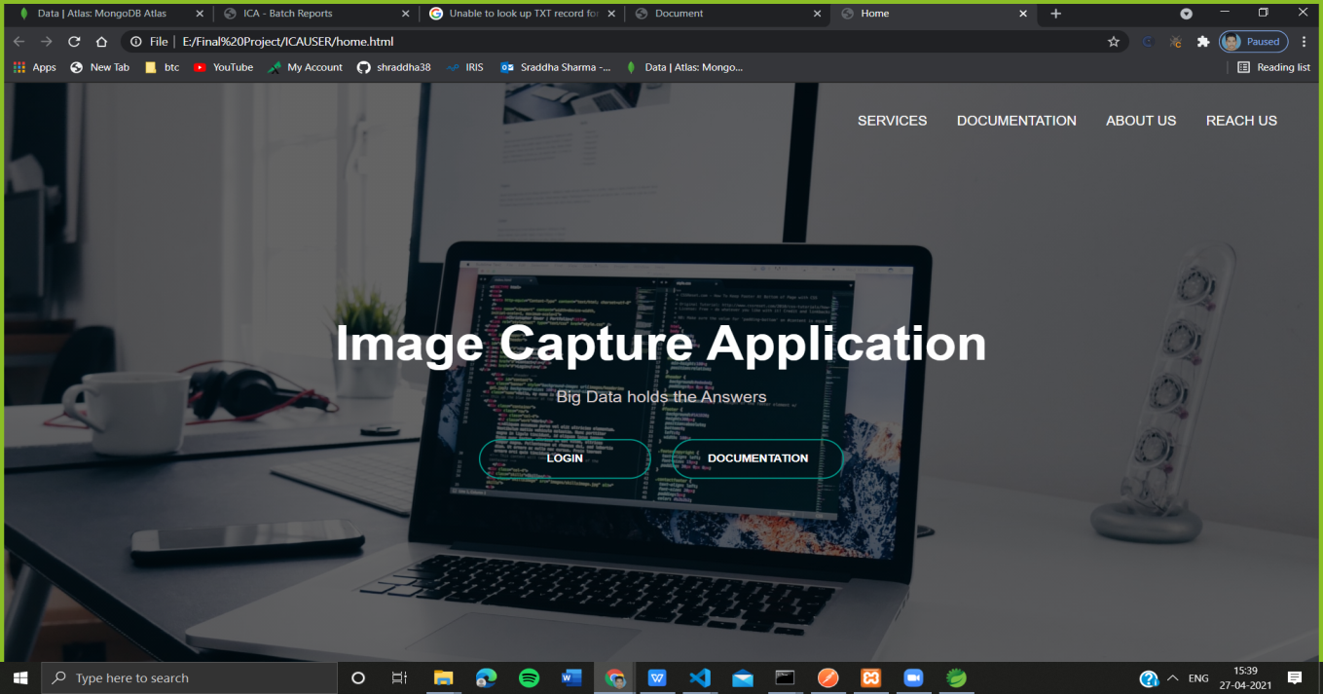
HOME PAGE

Slide 17
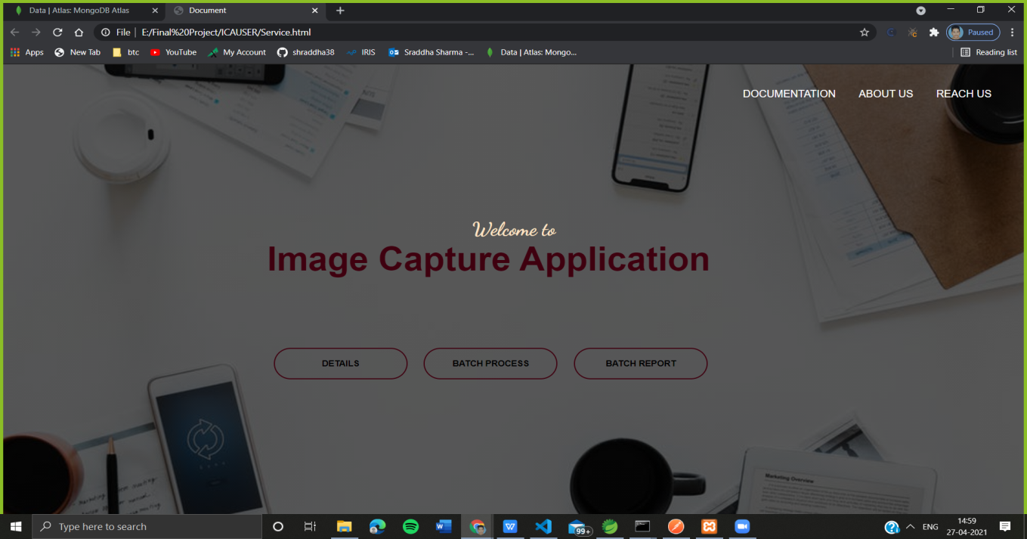
SERVICE PAGE

Slide 18
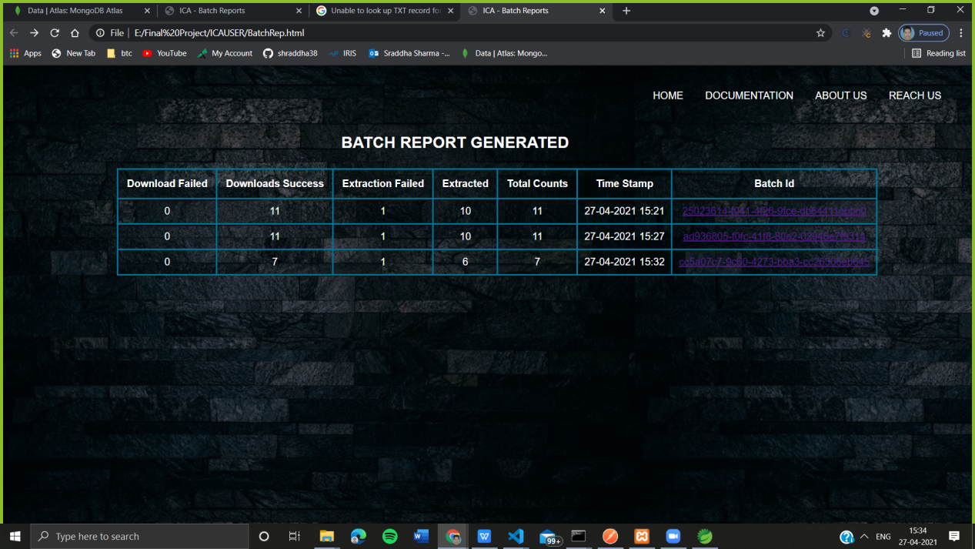
BATCH REPORTS

Slide 19
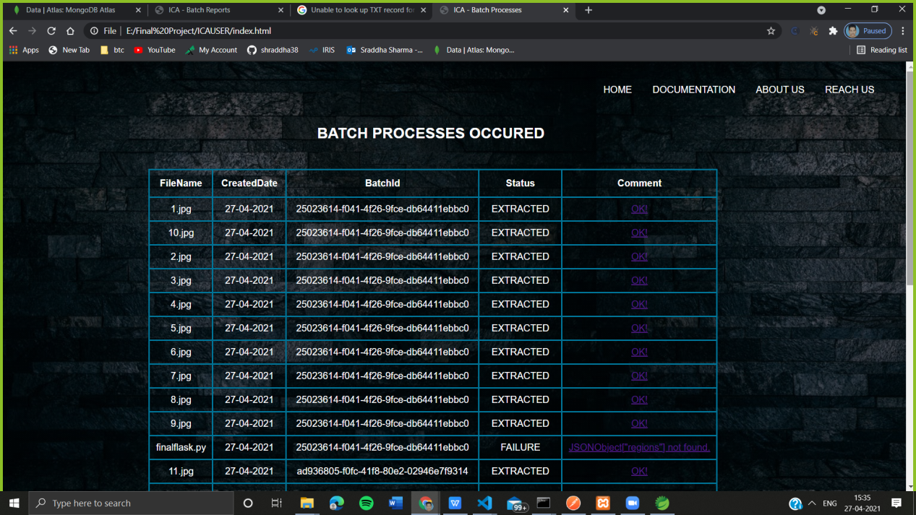
BATCH PROCESS OF PANCARDS

Slide 20
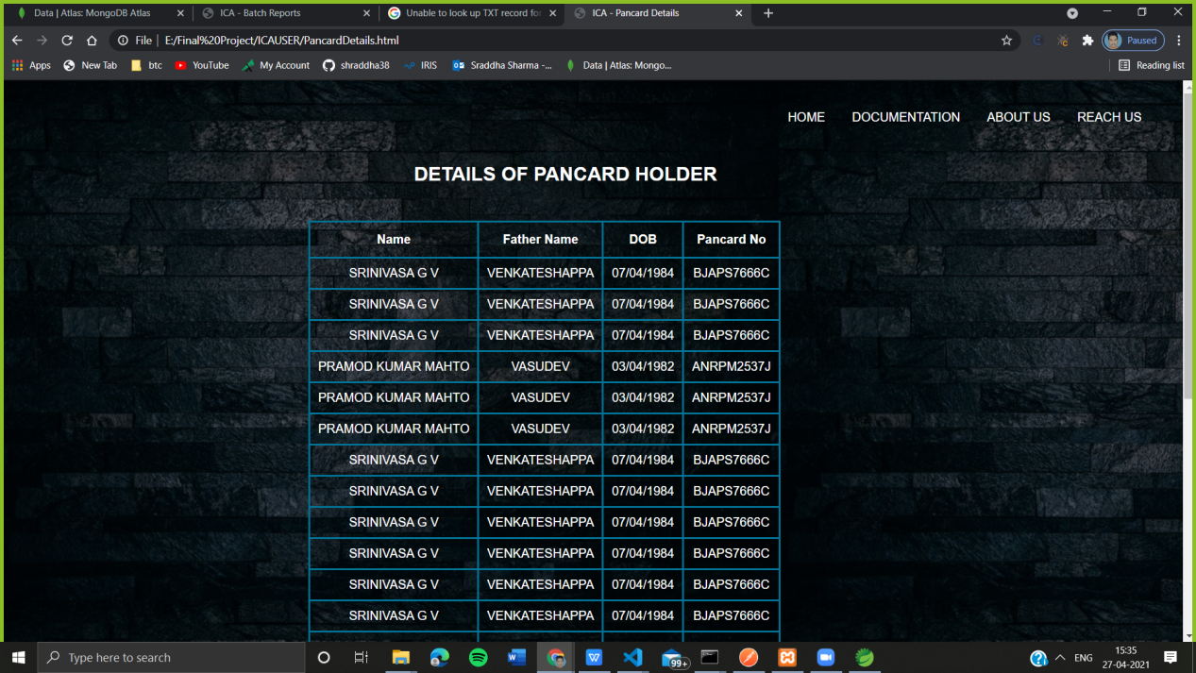
PROCESSED DATA

Slide 21
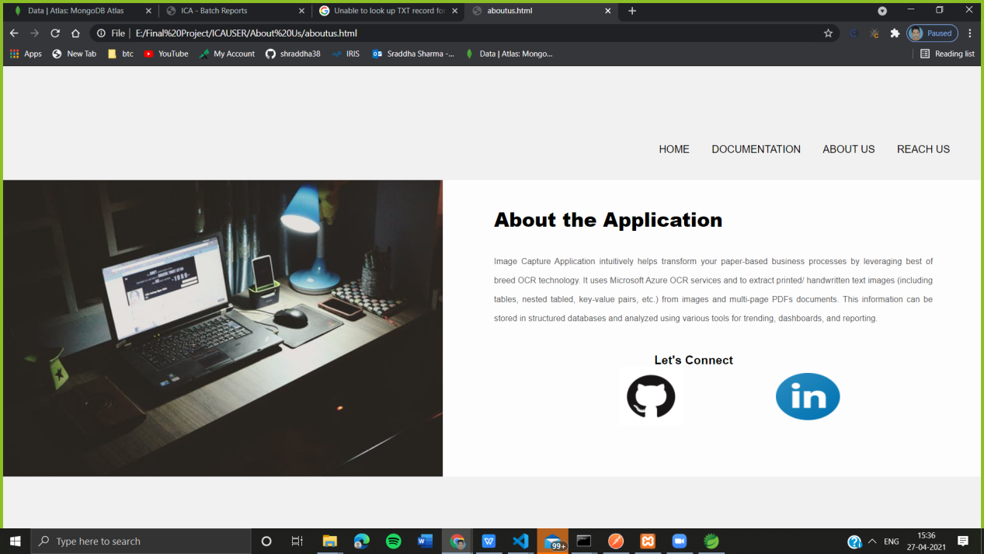
ABOUT US

Slide 22
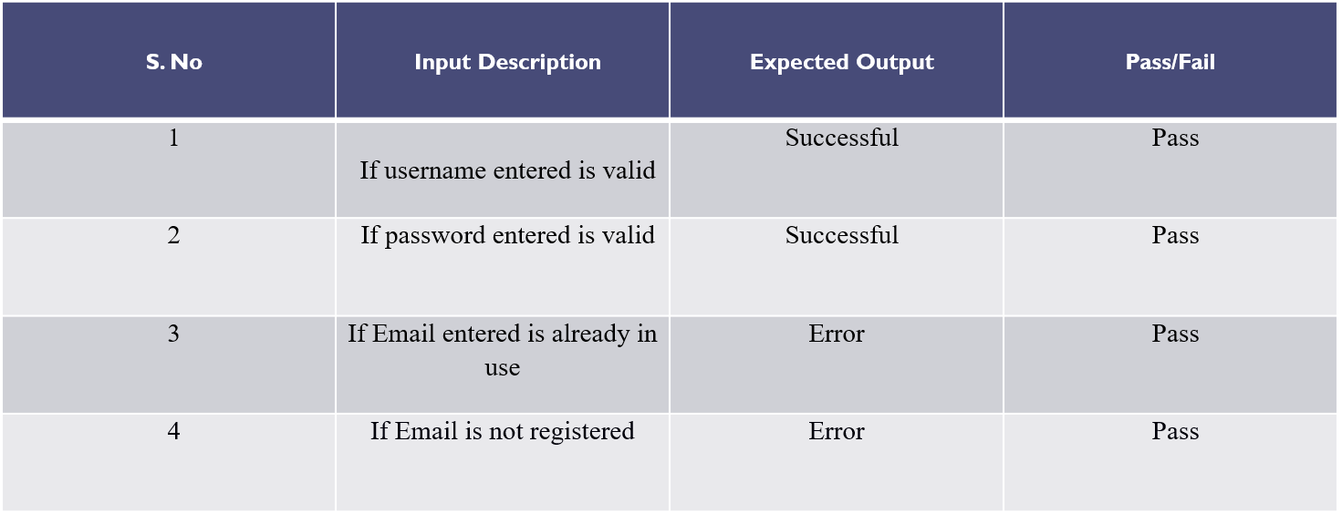
TESTING
Case 1: Login and Registration

Slide 23
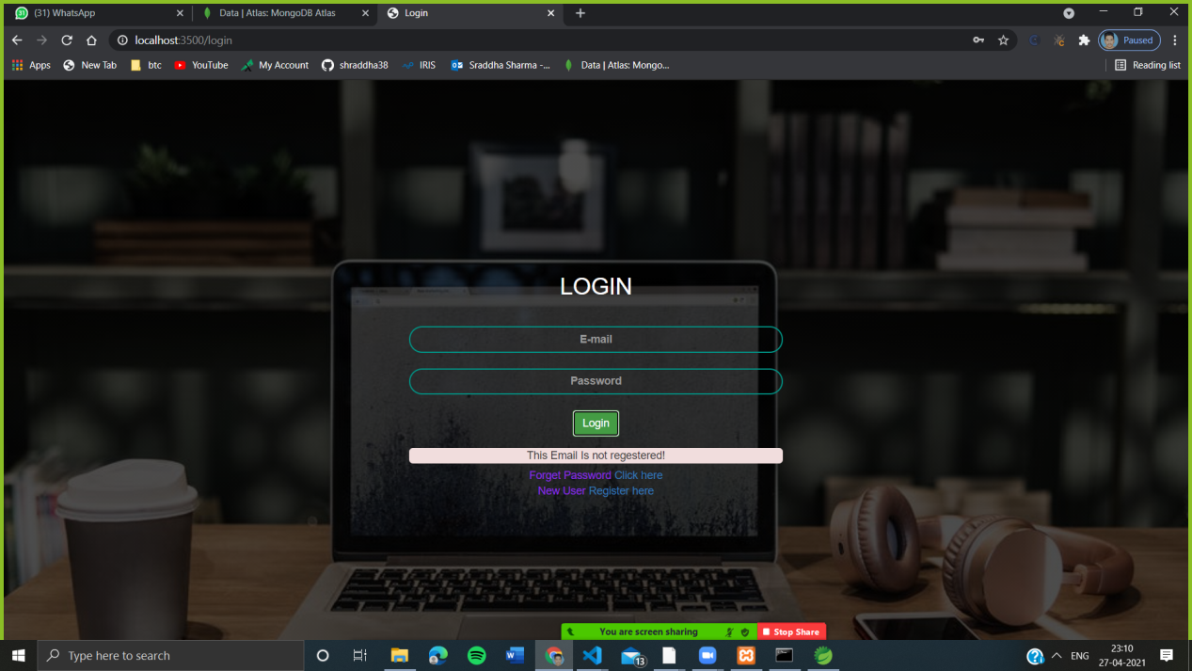
TESTING
Case 1: If Email is not registered

Slide 24
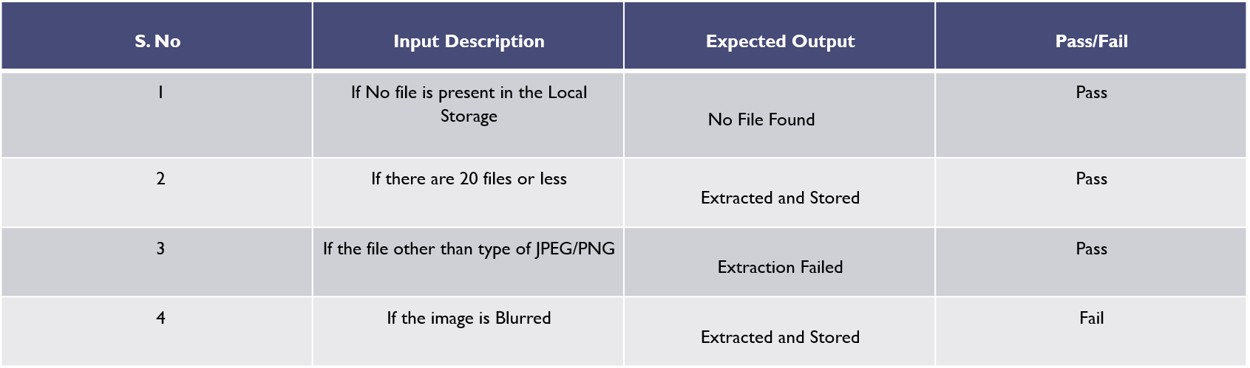
TESTING
Case 2: Application

Slide 25
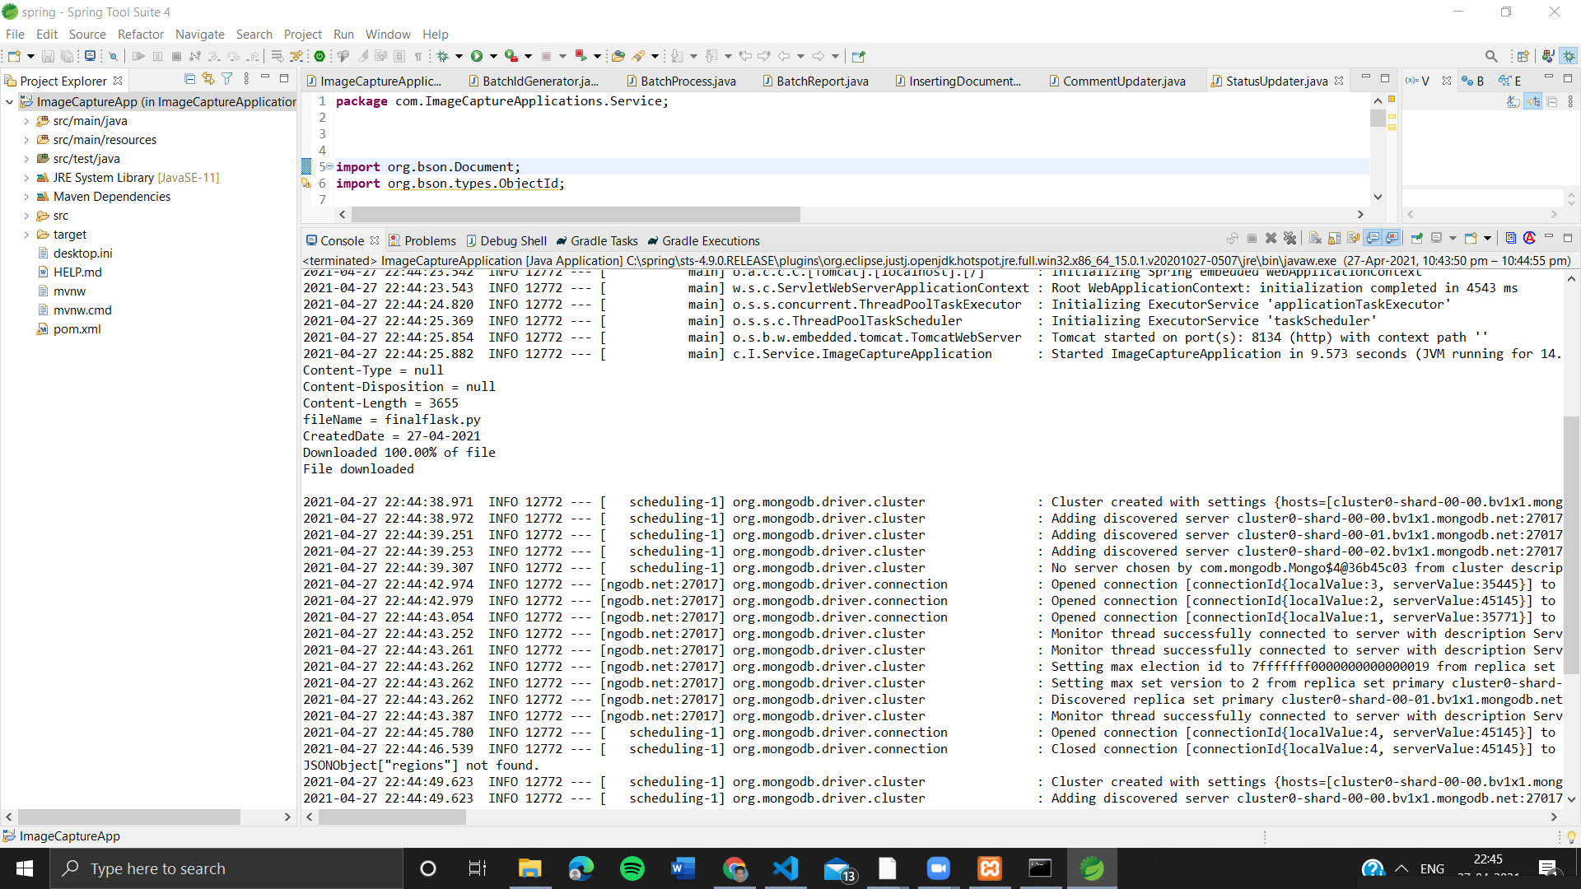
TESTING
If the file other than type of JPEG/PNG

Slide 26
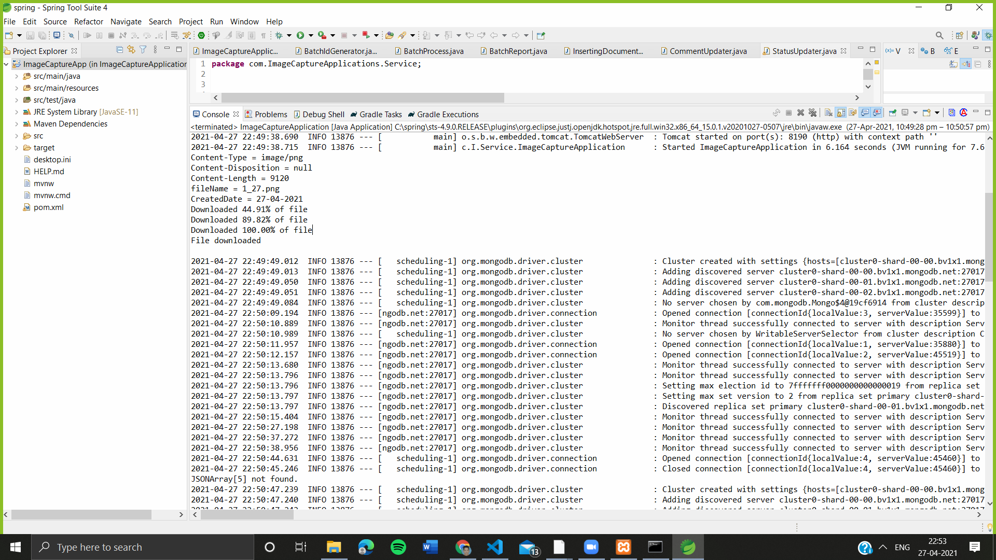
TESTING
If the Image of Pancard is Blurred

Slide 27
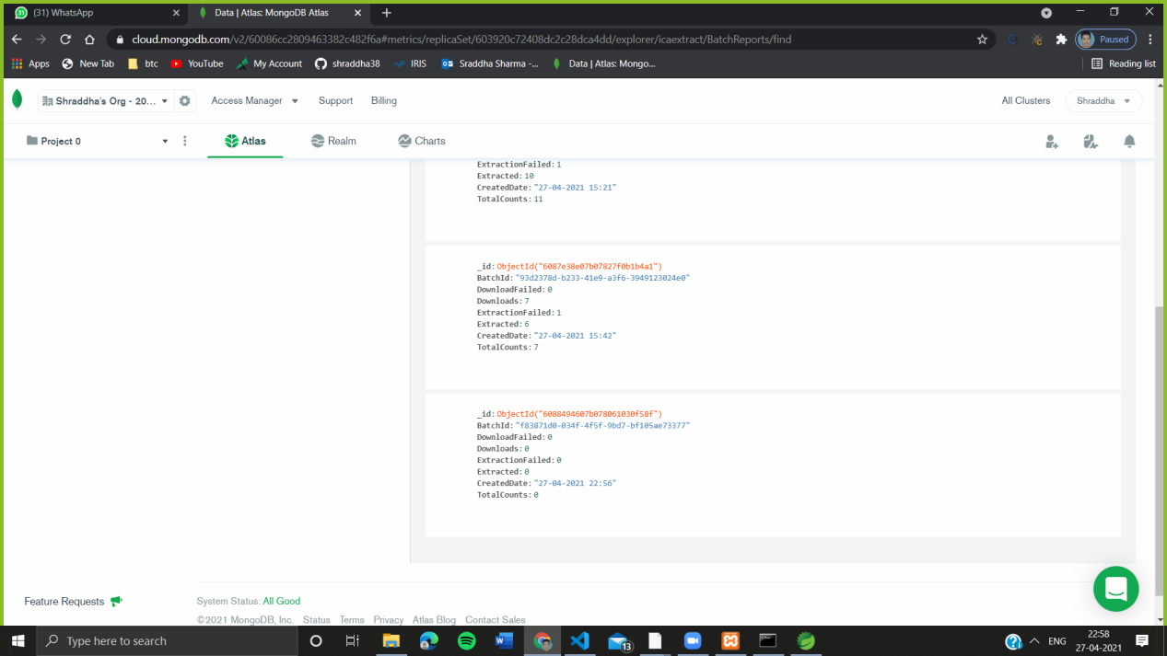
TESTING
If no file is Present in the Storage

Slide 28

FUTURE PERSPECTIVE
For Every Document without specifying template
Including all GOI documents like Aadhar, Driving License etc.
At Schools and Colleges for Digital Records
At Insurance Centers for document processing
At Healthcare sectors to store patient records digitally

Slide 29
CONCLUSION
Our Application intuitively helps transform your paper-based business processes by leveraging best of breed OCR technology. It Captures, classifies, and recognizes text.
Such Applications can help Organizations and Firms to Digitize their documents and move faster in the data driven world.

Slide 30

THANK YOU
Rahul Rathore
Lovely Professional University 11702112

